Slide 1
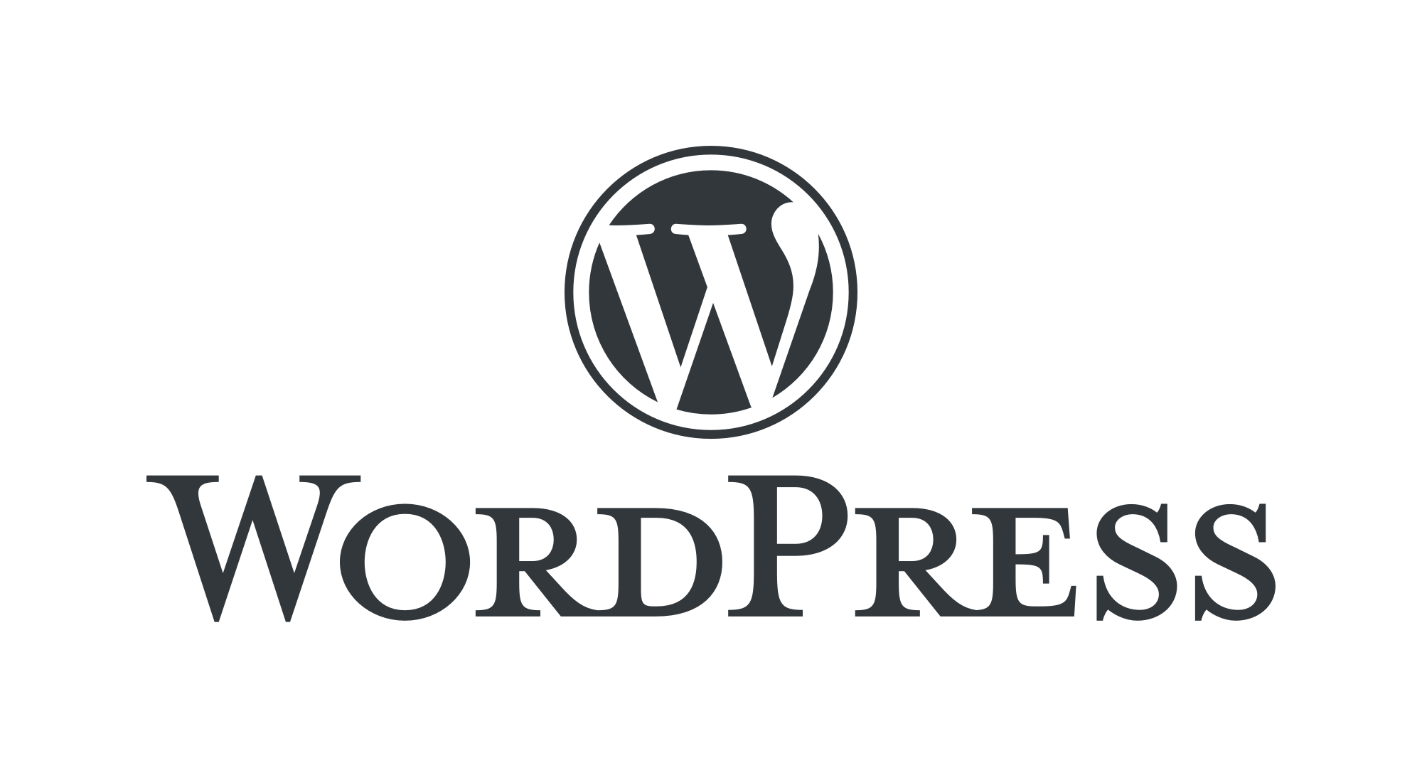
Wordpress Bug Bounty
–Nagendran

Slide 2
WARM UP
abracadabara
abracadabara
abracadabara

Slide 3


Personal Branding

Slide 4

Now & Future
∞

Slide 5
Wordpress Warmup
Recent Wordpress Version? https://wordpress.org/news/category/releases/
Recent Wordpress Vulnerability? https://patchstack.com/database/
It is written in PHP, Yes or No?
It is paired with MariaDB or MySQL, Yes or No?
It supports Shared and Managed hosting, Yes or No?

Slide 6
Qualifying Vulnerabilities
Any reproducible vulnerability that has a severe effect on the security or privacy of our users is likely to be in scope. Common examples include XSS, CSRF, SSRF, RCE, SQLi, and privilege escalation.

Slide 7
Top 10 Google Dorks for WordPress Vulnerabilities
Find WordPress login pages:
site:*.com inurl:wp-login.php ext:php
Default login paths to check: /wp-login.php, /wp-login/, /login/, /wp-login.php, /login.php

Slide 8
Top 10 Google Dorks for WordPress Vulnerabilities
2. Locate WordPress admin pages:
inurl:wp-admin.php ext:php
Login folders (may be renamed to hide it)
/wp-admin/login.php
/wp-admin/wp-login.php
/wp-admin.php
/wp-admin/

Slide 9
Top 10 Google Dorks for WordPress Vulnerabilities
3. Search for WordPress configuration files (exposed):
intitle:"Index of" "wp-config.php"
4. Find WordPress plugins directory (may expose vulnerabilities):
inurl:wp-content/plugins ext:php

Slide 10
Top 10 Google Dorks for WordPress Vulnerabilities
5. A sitemap XML file is automatically generated for all public posts, post types, and taxonomies:
inurl:wp-sitemap.xml
6. Find publicly accessible .htaccess files:
inurl:.htaccess

Slide 11
.htaccess file
1. Redirect URLs – Direct traffic from one URL to another.
2. Set up custom error pages – Display custom pages for errors like 404 Not Found.
3. Password protect directories – Restrict access to certain areas with authentication.
4. Enable or disable directory listings – Control whether file listings are shown when no index file is present.
5. Prevent access to specific files – Block access to sensitive files like `.env` or `wp-config.php`.

Slide 12
Top 10 Google Dorks for WordPress Vulnerabilities
7. Search for WordPress backups (potentially containing sensitive information):
intitle:"index of" "backup"
8. Locate exposed WordPress user directories:
inurl:wp-content/uploads "user"

Slide 13
Top 10 Google Dorks for WordPress Vulnerabilities
9. Find WordPress sites with potential SQL injection vulnerabilities:
inurl:wp-content/plugins/ inurl:comments
10. Find exposed WordPress admin pages:
inurl:wp-admin/admin-ajax.php

Slide 14
Wordpress XSS
WordPress XSS (Cross-Site Scripting) refers to an attack where malicious code or malware is injected into a website by exploiting a vulnerability in WordPress.
"XSS experts exploit WordPress, effortlessly embedding exploitative, evasive scripts."
– Nagendran.R

Slide 15
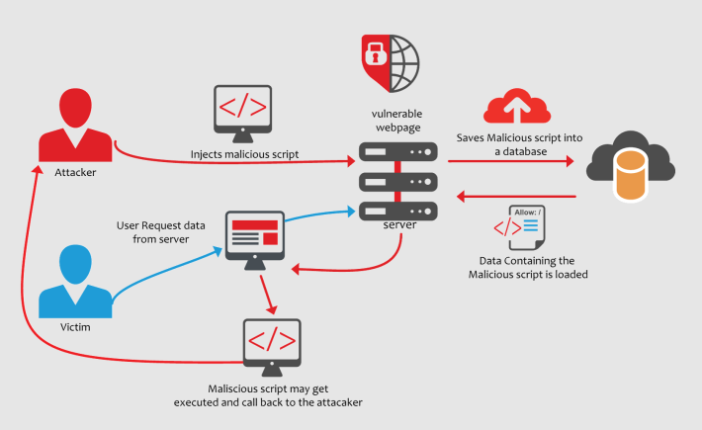
Wordpress XSS

Slide 16
List of Non Qualifying Vulnerabilities
Vulnerabilities with a CVSS score under 4.0 are out of scope unless combined with others for a higher score.
Brute force attacks are out of scope.
Denial of Service (DoS) attacks are out of scope.
Phishing attacks are out of scope.
Text injection attacks are out of scope.

Slide 17
List of Non Qualifying Vulnerabilities
Social engineering attacks are out of scope.
Wikis, Tracs, and forums allow user edits and are in scope.
XML-RPC file exposure needs a PoC showing a real security impact; DDoS and brute force are excluded.
Vulnerabilities in plugins not listed as in-scope should be reported to the Plugin Review team.
Reports for hacked websites are out of scope. Site owners should restore their sites.

Slide 18
List of Non Qualifying Vulnerabilities
11. Admins or editors can post arbitrary JavaScript.
12. Self-XSS in /wp-admin is out of scope unless a lower-privileged user can attack a higher-privileged user.
13. Disclosure of user IDs is out of scope.
14. Open API endpoints that serve public data like usernames and user IDs are out of scope.
15. Path disclosures for errors, warnings, or notices are out of scope.

Slide 19
List of Non Qualifying Vulnerabilities
16. Disclosure of WordPress version numbers is out of scope.
17. Mixed content warnings for passive assets like images and videos are out of scope.
18. Lack of HTTP security headers (CSP, X-XSS, etc.) is out of scope.
19. Automated scan outputs must be manually verified and include a valid PoC.
20. Low-impact vulnerabilities on certain sites like irclogs.wordpress.org are out of scope.

Slide 20
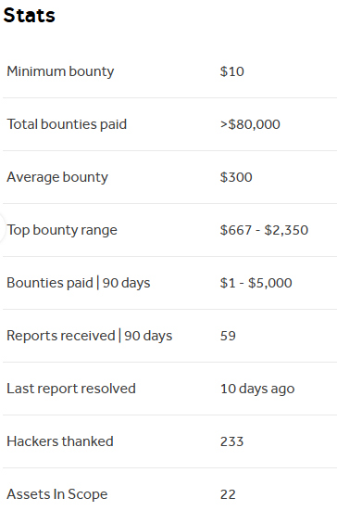
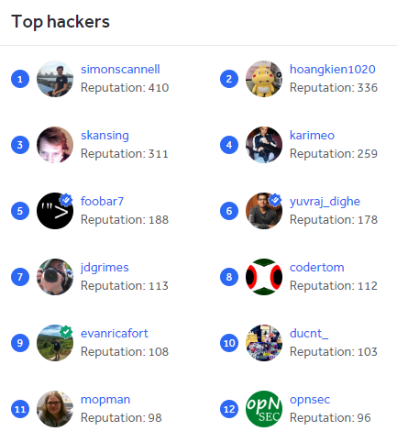

Slide 21
Wordpress User Enum - xmlrpc
XML-RPC, or XML Remote Procedure Call, is a protocol that allows applications to communicate with each other over a network.
It uses XML to encode messages and HTTP as a transport mechanism.

Slide 22
Wordpress User Enum - xmlrpc
XML-RPC is used in WordPress to enable communication between WordPress and other systems.
Publishing posts remotely
Creating, editing, and deleting posts
Uploading media files
Managing comments
Fetching user details

Slide 23
Wordpress User Enum - xmlrpc
DEMO
& Vevox Quiz

Slide 24
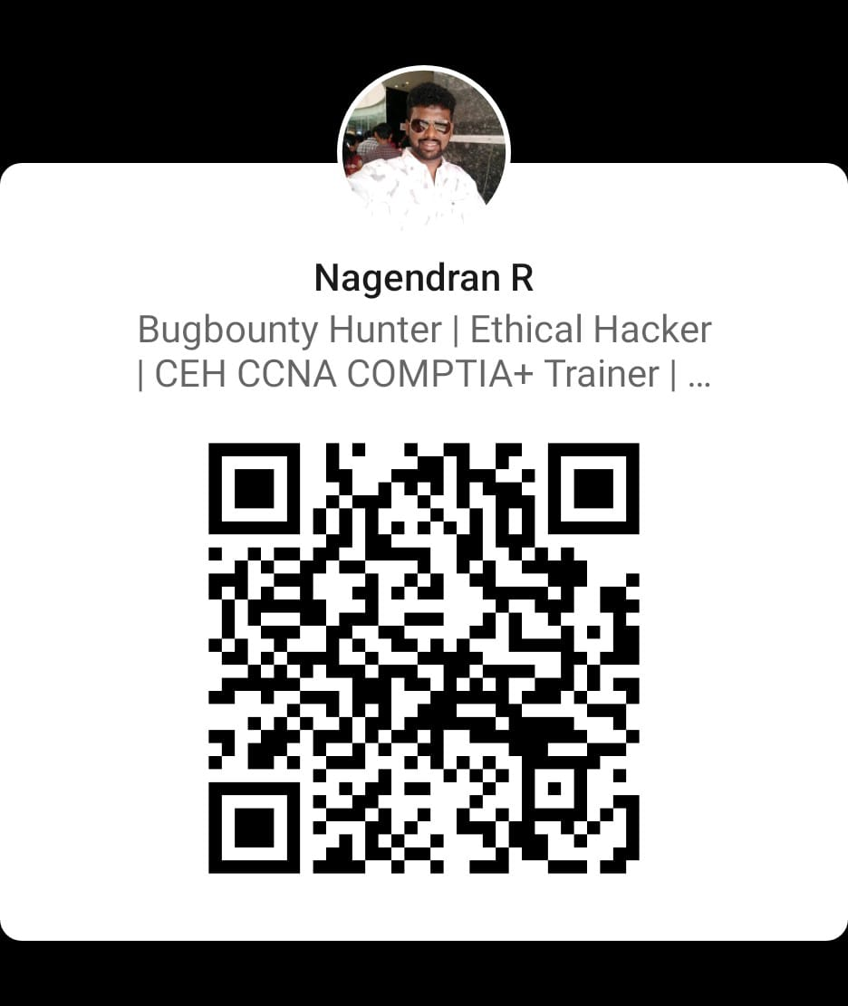
Connect With me
DEMO

Slide 25
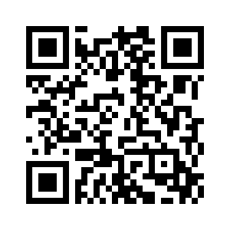
Wordpress User Enum - xmlrpc
DEMO

Slide 26



https://www.linkedin.com/in/pradeepnullchn/
Rootecstack
My Mentor (Mr.Pradeep Kumar)

Slide 27






Education Partner
Technology Partner
Community Partner

Slide 28


